Slide 1
Job Opportunities for Meteorologists in the growing Wind Energy Industry
Anna Lensch
anemos Gesellschaft für Umweltmeteorologie mbH

Slide 2
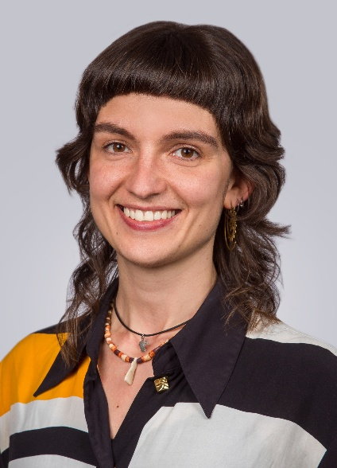
Introduction
2018 B. Sc. Meteorology
(JGU Mainz)
2023 M. Sc. Meteorology Troposphärische Umweltforschung (TrUmF)
(Freie Universität Berlin)
since 2024 anemos GmbH energy yield & site assessment
sound & shadow prognoses
Anna Lensch
Senior Expert Site Assessment
anemos Gesellschaft für Umweltmeteorologie mbH
Böhmsholzer Weg 3 | 21391 Reppenstedt / Lüneburg | Germany
anna.lensch@anemos.de | www.anemos.de

Slide 3
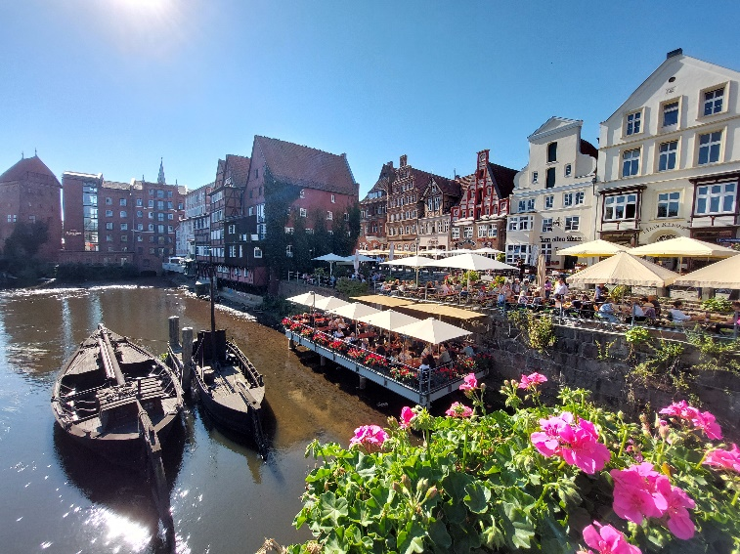





Introduction
founded 1990
Employees 46, ca. 16 meteorologists
Company headquarter in Lüneburg
Qualifications and memberships:

Slide 4
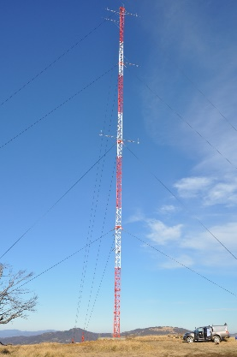
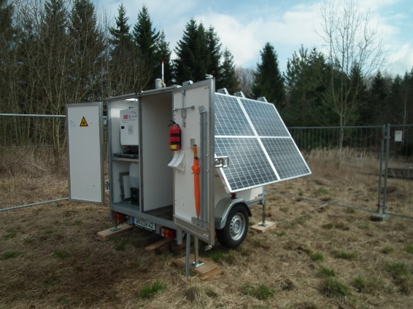
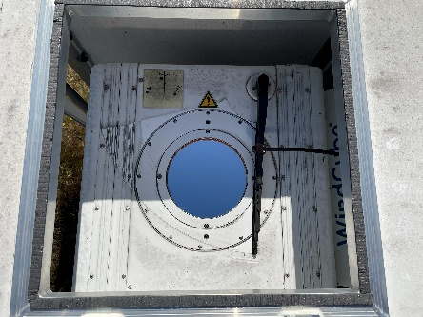
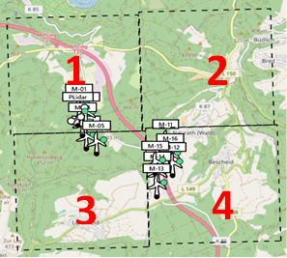
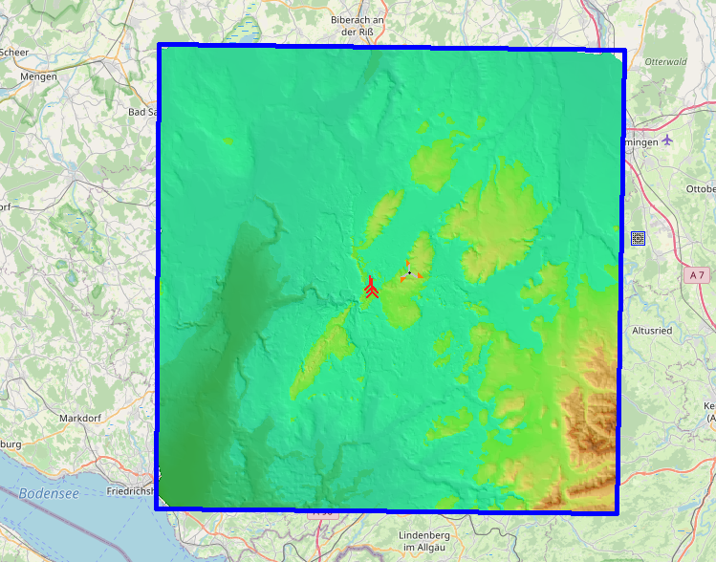
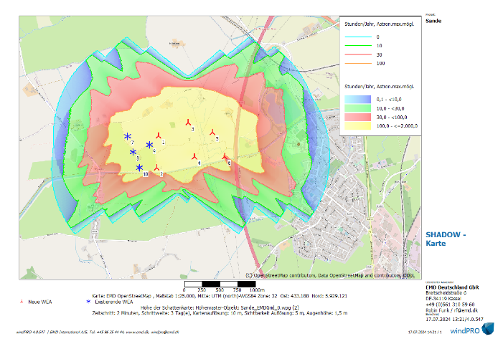
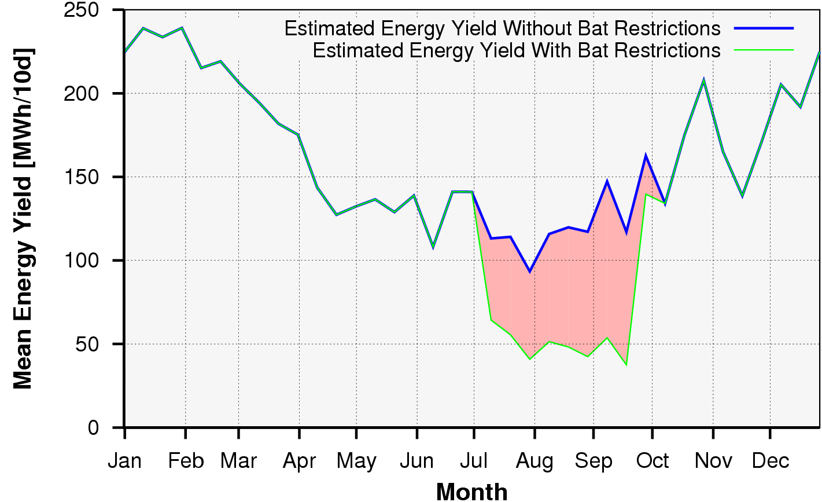
1. Site assessment
What do we do?
Wind measurements
Energy yield assessments
Environmental studies (noise, shadow)

Slide 5
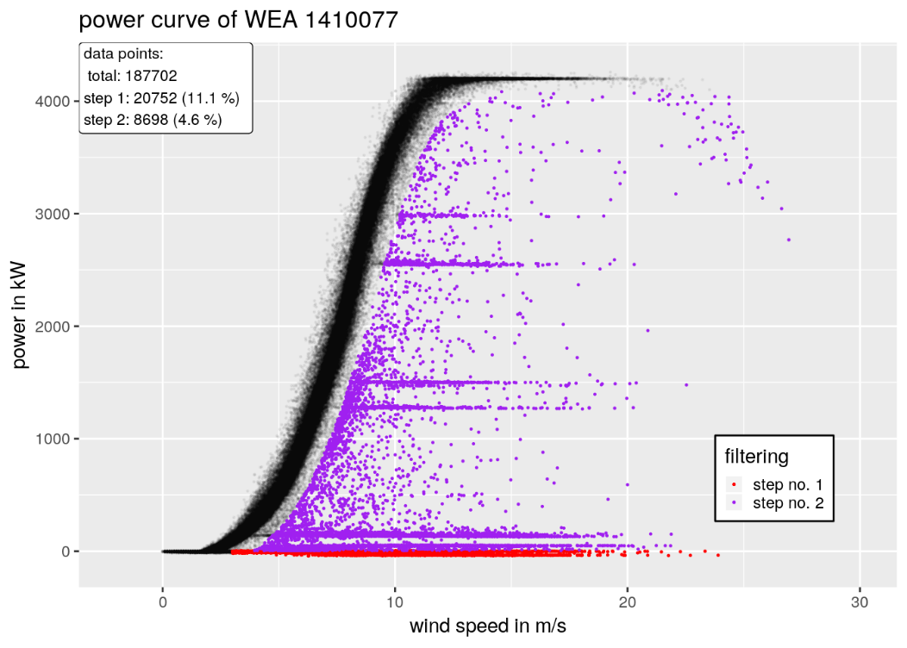
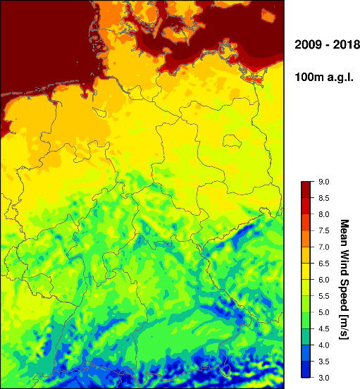
2. Power performance analysis
What do we do?
3. Windatlas: mesoscale modelling (WRF)
Real life performance check
Optimization
High-resolution map of atmospheric parameters (wind speed, extreme values, icing, turbulence etc.)
Using our wind measurements and reanalysis data

Slide 6
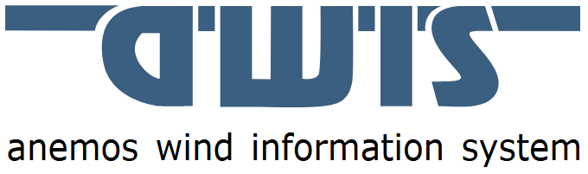
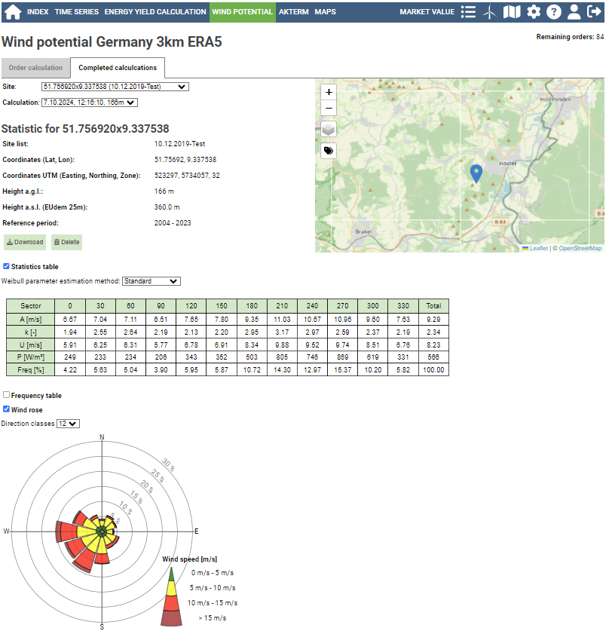

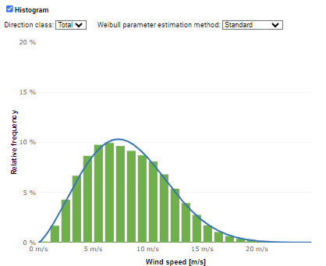
4.
What do we do?
5. Electricity market analysis
Market value atlas
Revenue report
Risk analysis
6. Research & Development
Publications based on atmospheric modelling focussing on wind energy
Projects: STRAIGHT, OTELLO, BY & UBA Windatlas, SUnDAY, VERIMA, Roadmap Windatlas, WinBin II, SOPCAWIND, Windaus
Publications: H.-T. Mengelkamp et al. 2025, Schneider et al. 2021, Weiter et al. 2018 etc.
Online tool to simulate your own wind park (time series, statistics, maps etc.)

Slide 7
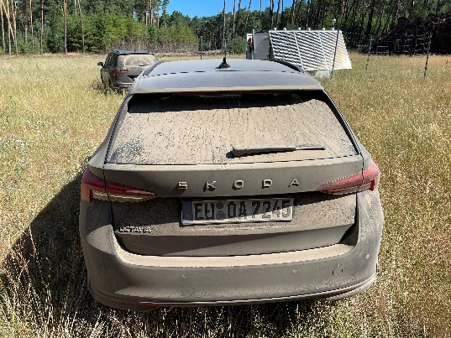
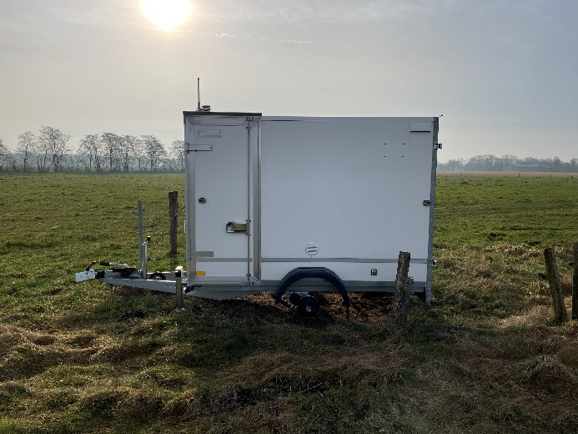
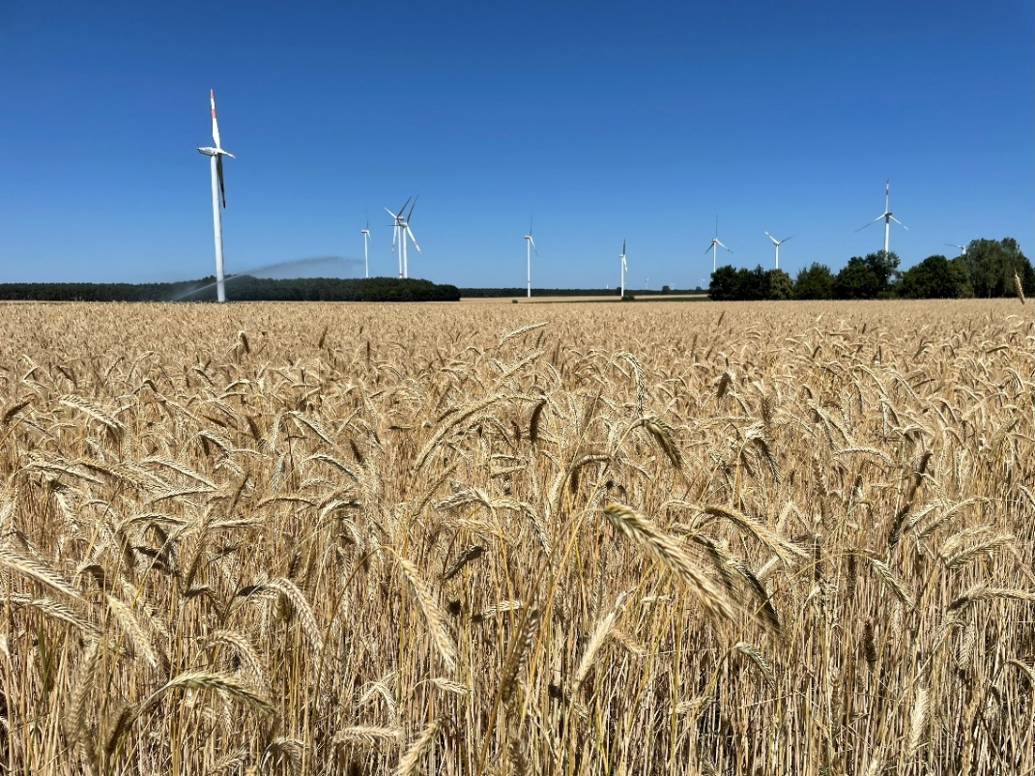
Student jobs
Work remotely
Site visits: drive through Germany, document planned sites or wind measurements
Process wind data
Work on Windatlas
etc. …

Slide 8
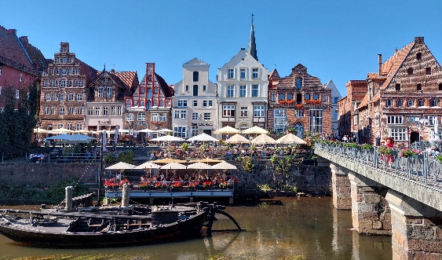
We offer …
Permanent full-time position with flexible working hours
Part-time and remote work possible
Time recording
Scope of work according to wishes
Personal, young and fun team 🦄
Benefits: Deutschlandticket, company pension scheme, Christmas & New Year’s off etc.
Company trips: summer outing, Christmas party & more
Vacancies (but not limited to): https://anemos.de/de/informationen.php#jobs

Slide 9
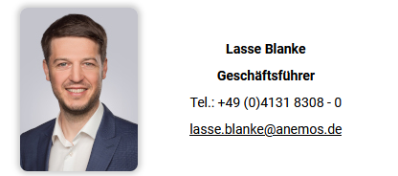
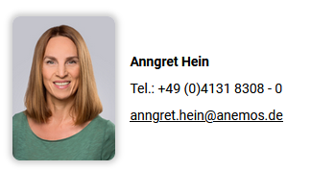
Thank you for listening!
For any job enquiries, feel free to contact either me or one of my colleagues :)
Anna Lensch
Senior Expert Site Assessment
anemos Gesellschaft für Umweltmeteorologie mbH
Böhmsholzer Weg 3 | 21391 Reppenstedt | Germany
anna.lensch@anemos.de | www.anemos.de

Slide 10
Attachments

Slide 11
Main activities
Site assessment
WAsP / CFD
Environmental studies (noise, shadow)
Site quality / Due Diligence
Wind measurements (mast, Lidar)
Estimation of wind potential

Slide 12

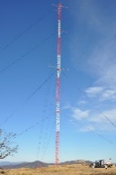
Main activities
Site assessment
WAsP / CFD
Environmental studies (noise, shadow)
Site quality / Due Diligence
Wind measurements (mast, Lidar)
Estimation of wind potential
Energy yield calculation

Slide 13
Main activities
Site assessment
WAsP / CFD
Environmental studies (noise, shadow)
Site quality / Due Diligence
Wind measurements (mast, Lidar)
Estimation of wind potential
Energy yield calculation
Calculation of yield reduction (losses)

Slide 14
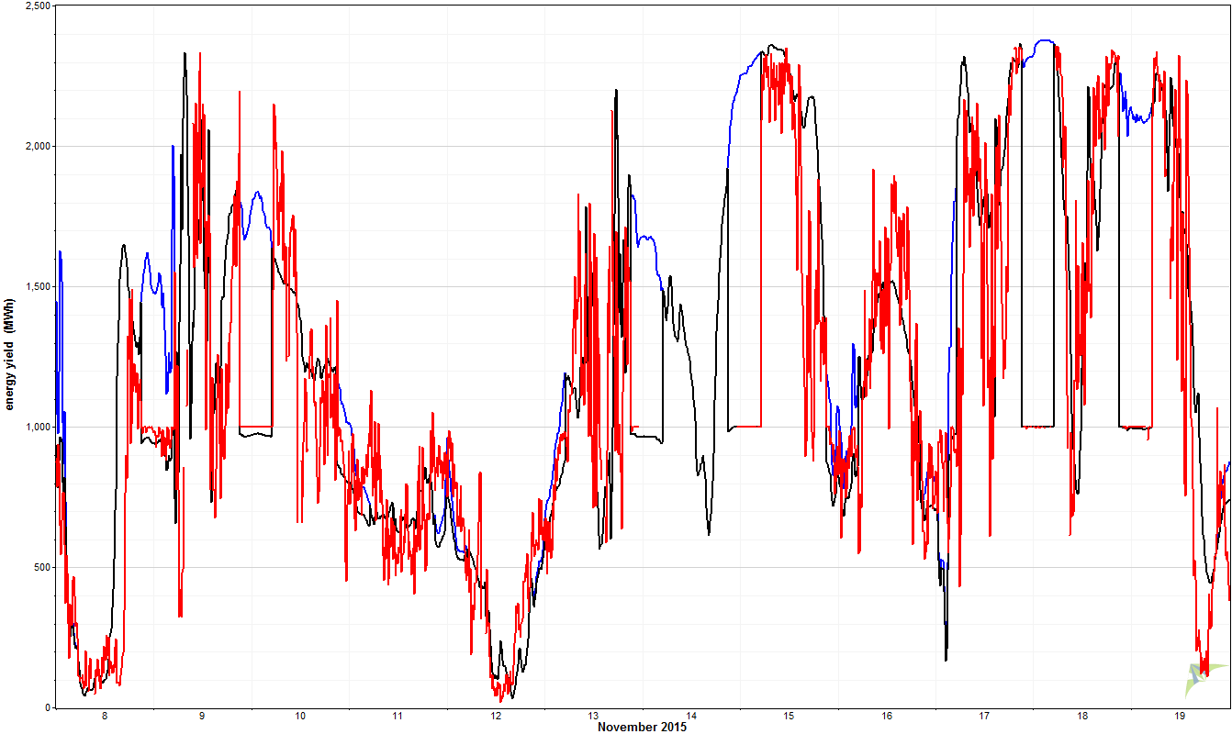
Main activities
Site assessment
WAsP / CFD
Environmental studies (noise, shadow)
Site quality / Due Diligence
Wind measurements (mast, Lidar)
Power performance analysis
SCADA-data analysis + TR10, Optimization, Performance Check / Due Diligence, Portfolio analysis (wind+solar)
noise reduction at night

Slide 15
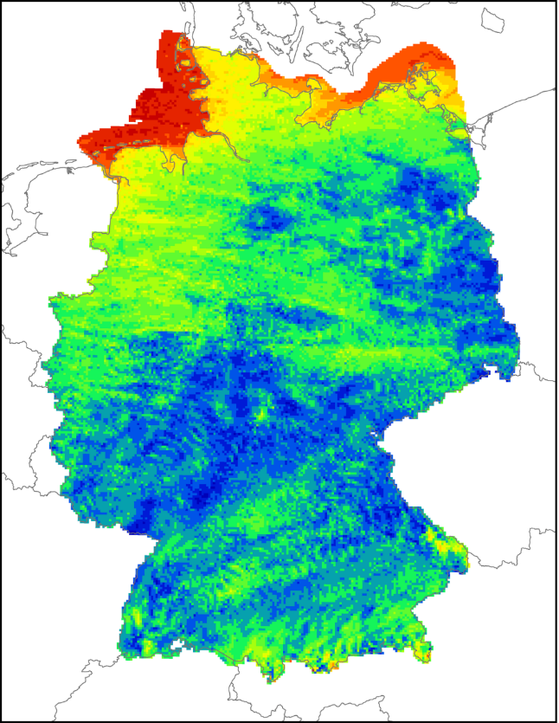
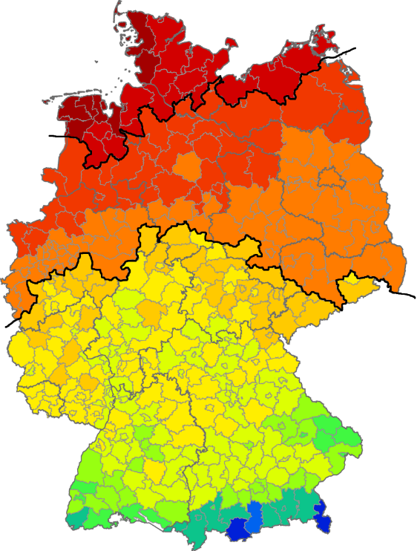
Main activities
Site assessment
WAsP / CFD
Environmental studies (noise, shadow)
Site quality / Due Diligence
Wind measurements (mast, Lidar)
Mesoscale modelling (WRF)
Windatlas Optimization, 50-year extreme values, icing, index, turbulence intensity, 10-min. time series
Power performance analysis
SCADA-data analysis + TR10, Optimization, Performance Check / Due Diligence, Portfolio analysis (wind+solar)
Wind atlas
Extreme values

Slide 16
Main activities
Site assessment
WAsP / CFD
Environmental studies (noise, shadow)
Site quality / Due Diligence
Wind measurements (mast, Lidar)
Mesoscale modelling (WRF)
Windatlas Optimization, 50-year extreme values, icing, index, turbulence intensity, 10-min. time series
Power performance analysis
SCADA-data analysis + TR10, Optimization, Performance Check / Due Diligence, Portfolio analysis (wind+solar)
awis
Online data access
(time series, maps, statistics, indices)
Wind potential, Yield estimation
Market value atlas, PPA-Atlas

Slide 17
Main activities
Site assessment
WAsP / CFD
Environmental studies (noise, shadow)
Site quality / Due Diligence
Wind measurements (mast, Lidar)
Mesoscale modelling (WRF)
Windatlas Optimization, 50-year extreme values, icing, index, turbulence intensity, 10-min. time series
Power performance analysis
SCADA-data analysis + TR10, Optimization, Performance Check / Due Diligence, Portfolio analysis (wind+solar)
Electricity market analysis
Market value atlas
Revenue report
Risk analysis for PPA‘s
awis
Online data access
(time series, maps, statistics, indices)
Wind potential, Yield estimation
Market value atlas, PPA-Atlas

Slide 18
Main activities
Site assessment
WAsP / CFD
Environmental studies (noise, shadow)
Site quality / Due Diligence
Wind measurements (mast, Lidar)
Mesoscale modelling (WRF)
Windatlas Optimization, 50-year extreme values, icing, index, turbulence intensity, 10-min. time series
Power performance analysis
SCADA-data analysis + TR10, Optimization, Performance Check / Due Diligence, Portfolio analysis (wind+solar)
Electricity market analysis
Market value atlas
Revenue report
Risk analysis for PPA‘s
awis
Online data access
(time series, maps, statistics, indices)
Wind potential, Yield estimation
Market value atlas, PPA-Atlas
Research & Development
STRAIGHT, OTELLO, BY & UBA Windatlas, SUnDAY, VERIMA, Roadmap Windatlas, WinBin II, SOPCAWIND, Windaus

Slide 19
Requirements
University degree Master/Bachelor: Meteorology, Geography ....
Motivation for renewable energies
Project work (time management, deadlines, customer contact)
Dealing with people from outside the field
Willingness to deal with other areas
Foreign languages (international market)

Slide 20
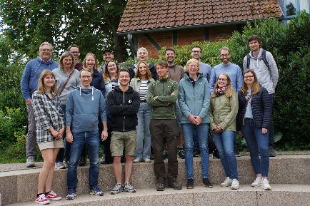
We offer…
Permanent full-time position with flexible working hours
Time recording - overtime can be deducted
Possibility to work more than 50% from home
Scopes of work are tried to be adapted according to wishes
Small, young and motivated team
Benefits:
Subsidies for local public transport
Company Pension Scheme
Company trips:
Company summer outing
Christmas party
Life and living in Lüneburg or Hamburg

